Slide 1
Linux
Julio César Almada Fuerte
A00226046
ITE

Slide 2
Step 1)
Download the Linux distribution Image(Download the latest versión)
It can be the console or desktop version:
http://download.terasic.com/downloads/cd-rom/de10-standard/Linux/DE10-Standard_Linux_Console.zip
Or
https://www.terasic.com.tw/cgi-bin/page/archive.pl?Language=English&No=1081&PartNo=4

Slide 3
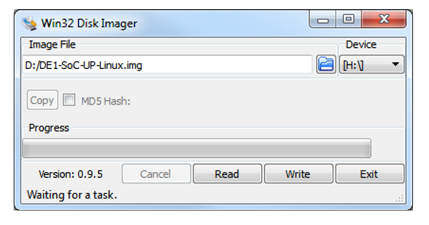
Step 2) Prepare the Linux MicroSD card
For this you need to download the Win 32 Disk imager:
https://sourceforge.net/projects/win32diskimager/

Slide 4
Step 2) Cont.
1- Insert your MicroSD into your computer microSD card slot.
2- You are going to pick the image you downloaded on step 1.
3- You are going to choose your MicroSD as your Device.
4- Click on write and wait for the process to end.

Slide 5
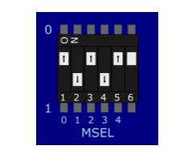
Step 3) Configure your DE10 board for Linux
You must configure the MODE SELECT (MSEL) of your board for it to be able to boot Linux.
Connect your DE10 board with the host computer using a USB cable or Network Connection.

Slide 6
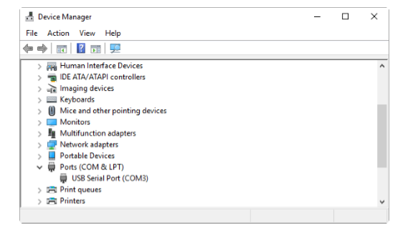
USB
Download a terminal program like Putty: https://www.putty.org/
On Windows you have to make sure that the corresponding drivers are installed on the Device manager

Slide 7
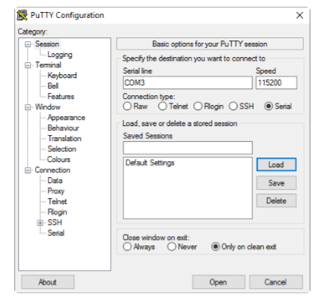
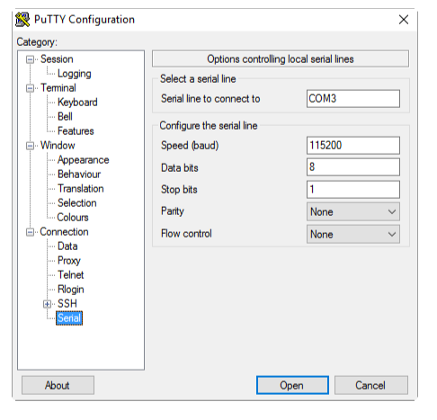
On putty you have to configure the connection as shown

Slide 8
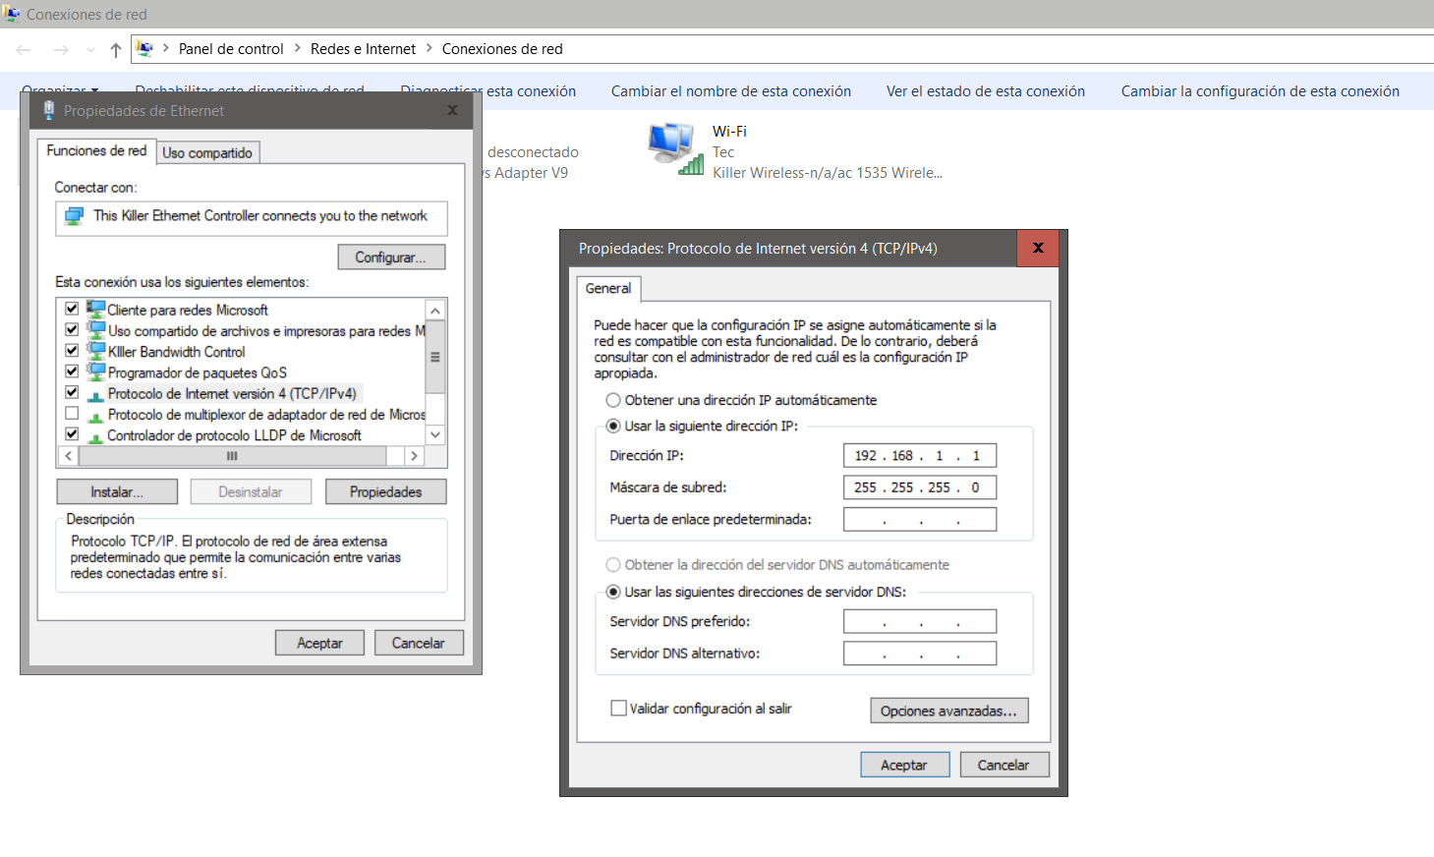
Network Connection
Configure the Network port from your computer as shown:

Slide 9
To configure the network connection for your FPGA you will need to configure it by Putty, but it will make your work easier when transferring files from your host computer to your Device.
In putty you have to configure its ethernet connection as this:
ifconfig eth0 192.168.1.2 netmask 255.255.255.0 up
This will make you device able to communicate with your Host computer through an ethernet connection.

Slide 10
For your ethernet connection to work
Open another putty window and connect with your device through ssh with the IP direction: 192.168.1.2
Now you are able to interact with your device through the ethernet connection

Slide 11
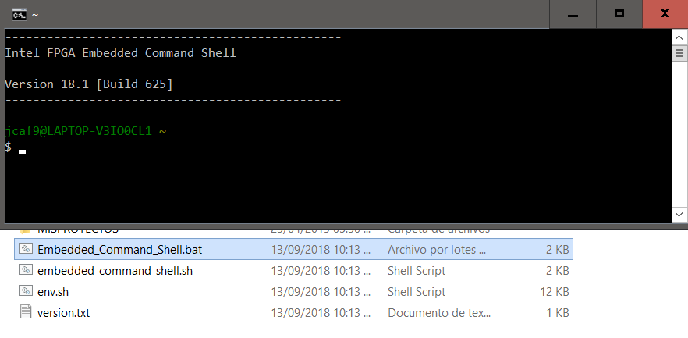
To trasnfer files you will need:
1- Download the latest versión of SoC FPGA EDS from here: http://fpgasoftware.intel.com/soceds/
2- Open the program Embedded_Command_Shell.bat

Slide 12
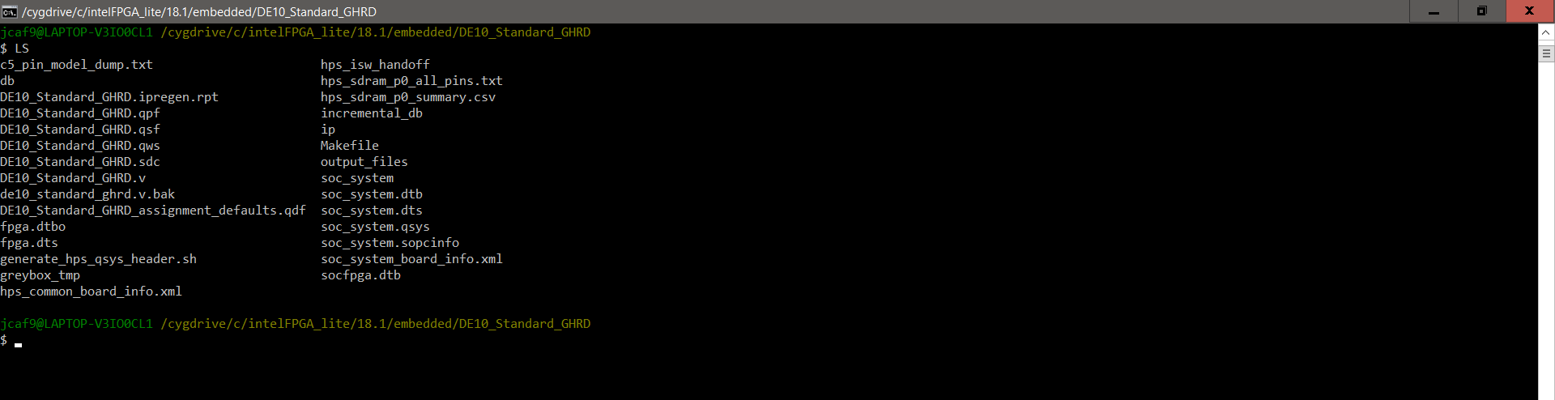
3- Move to the folder where the file you want to transfer to the FPGA is.

Slide 13
4 – Use this command: scp my_first_hps root@192.168.1.2:/home/root
Where my_first_hps can be any file

Slide 14
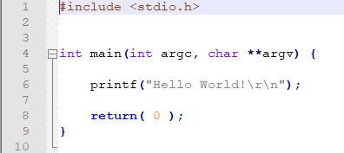
How to compile programs on the EDS
1- Create a Project folder:
C:\intelFPGA\18.1\embedded\my_first_hps
2- Create a design file:

Slide 15
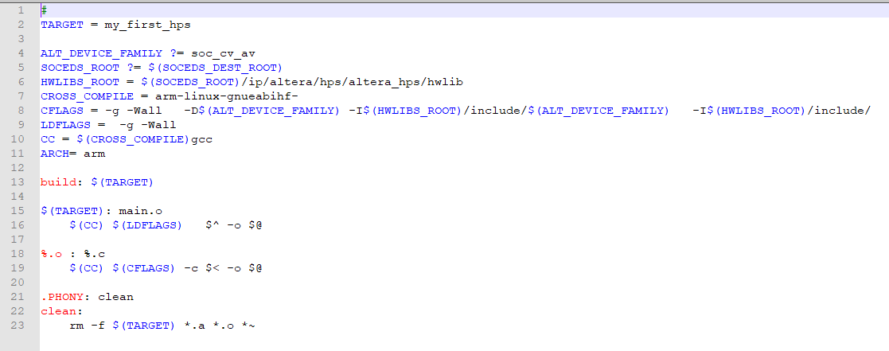
3 – Create a Makefile

Slide 16
4- Go into your Project folder through the EDS and type make to get your executable file, make sure it compiles so you can use it on your device
5- Transfer that file through your network connection to your FPGA as shown in the last section.

Slide 17
Execute your executable file
On your putty terminal connected to your device type “ls” to verify that the executable was transfered
Once you find the executable type “./my_first_hps” where my_first_hps can be any executable file.
Verify that it worked.

Slide 18
How to use HPS SoC and FPGA
The HPS logic and FPGA fabric are connected through an AXI bridge. You will need to configure this connection through Qsys to make it work.
For this you will need to create a GHRD Project(Golden Hardware Reference Desgin).
You can find an example on the CD provided on this link: https://www.terasic.com.tw/cgi-bin/page/archive.pl?Language=English&No=1081&PartNo=4

Slide 19
The example included in that folder is:
DE10_Standard_GHRD
To use the GHRD provided you will need to download quartus prime(Latest version) to make the connection between the FPGA and HPS components.
https://www.intel.com/content/www/us/en/programmable/downloads/download-center.html

Slide 20
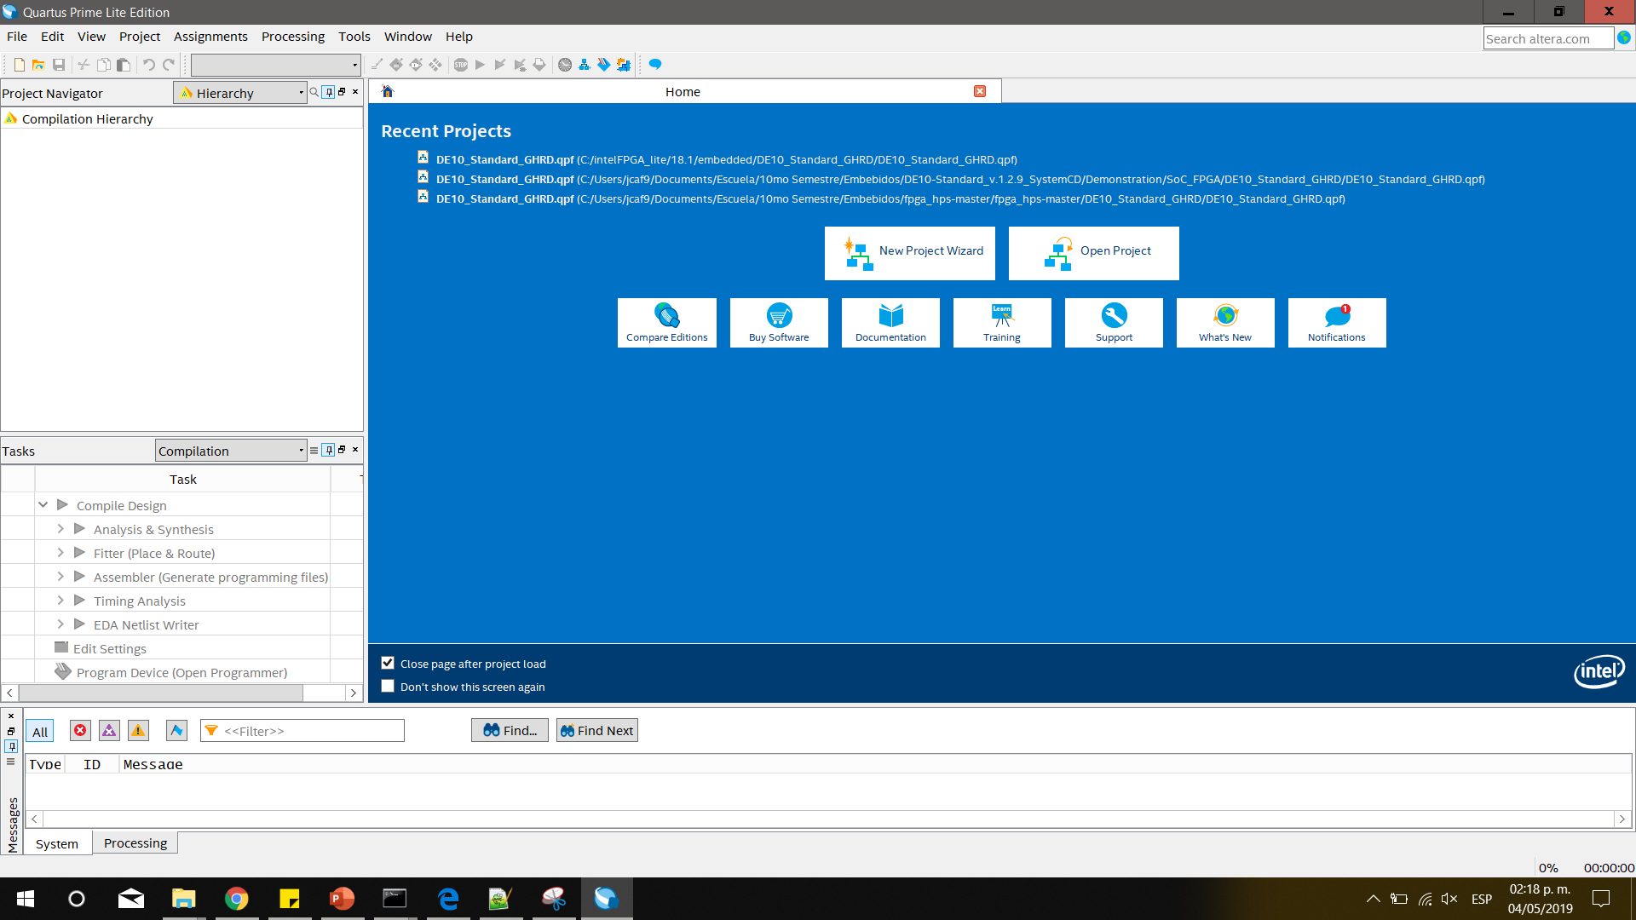
Once downnloaded and installed open quartus

Slide 21
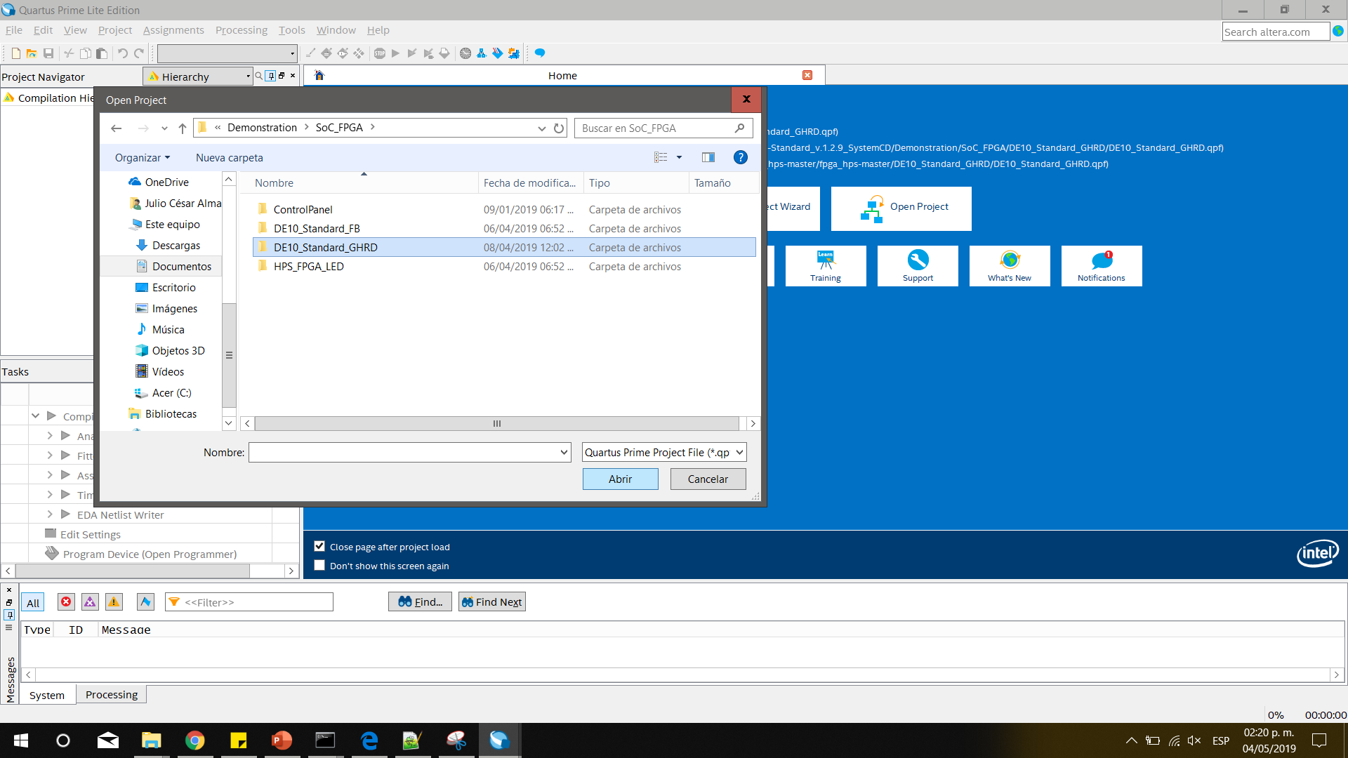
Open the Project provided

Slide 22
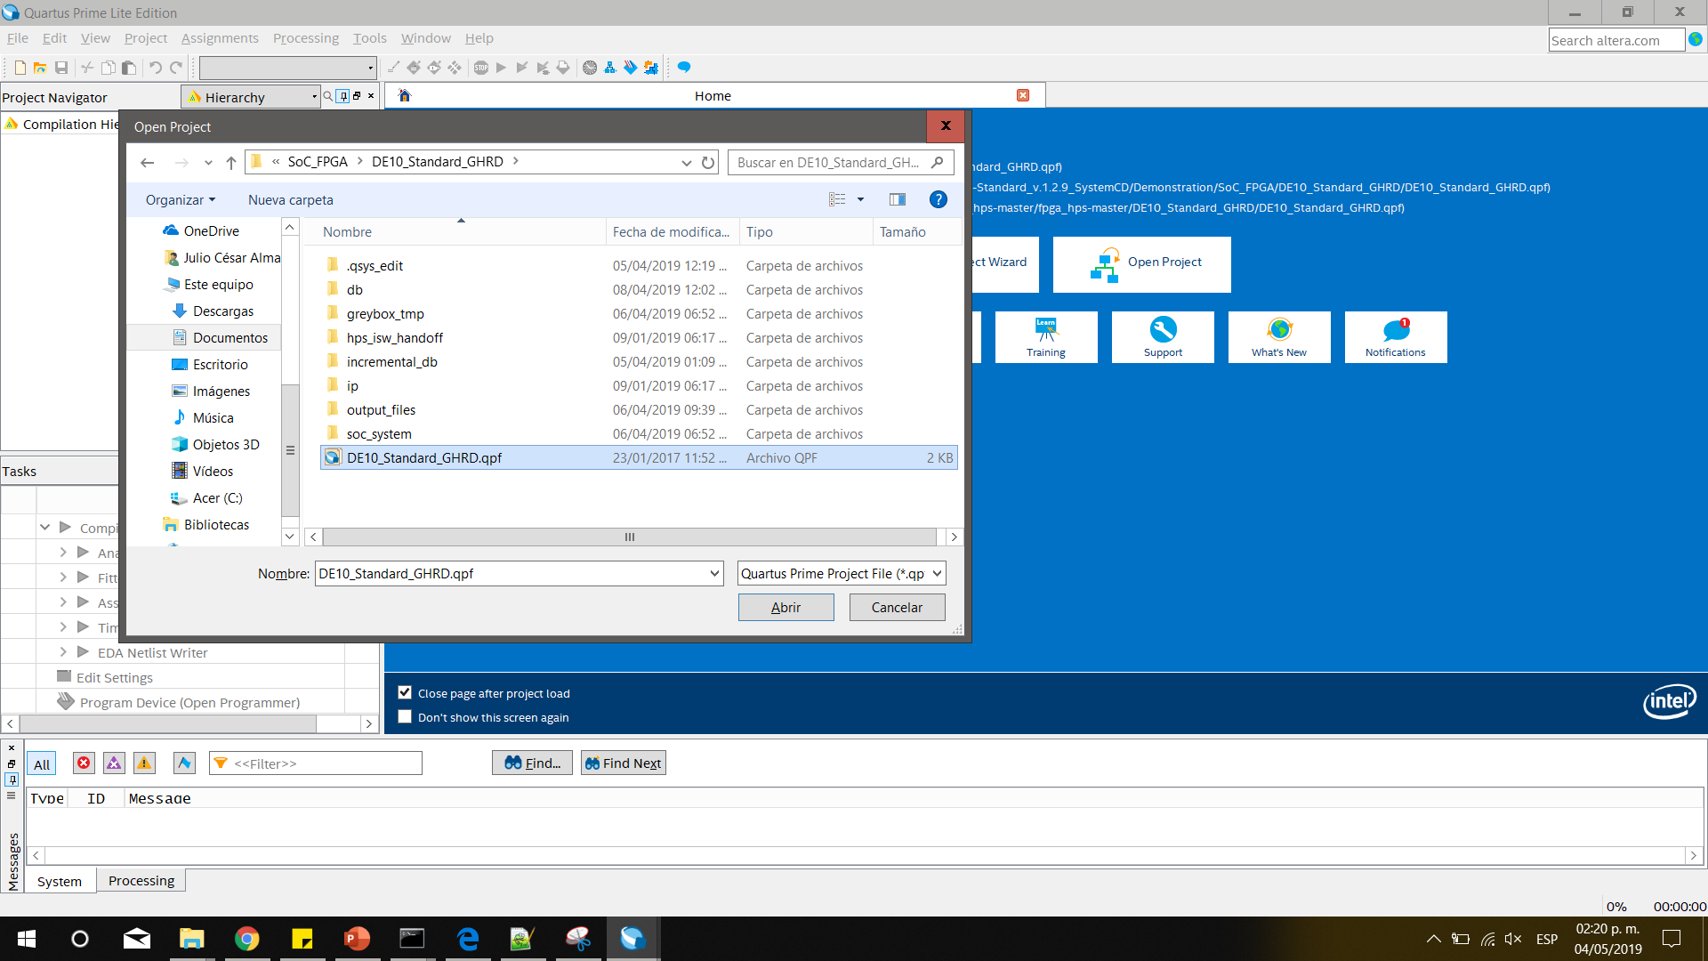

Slide 23
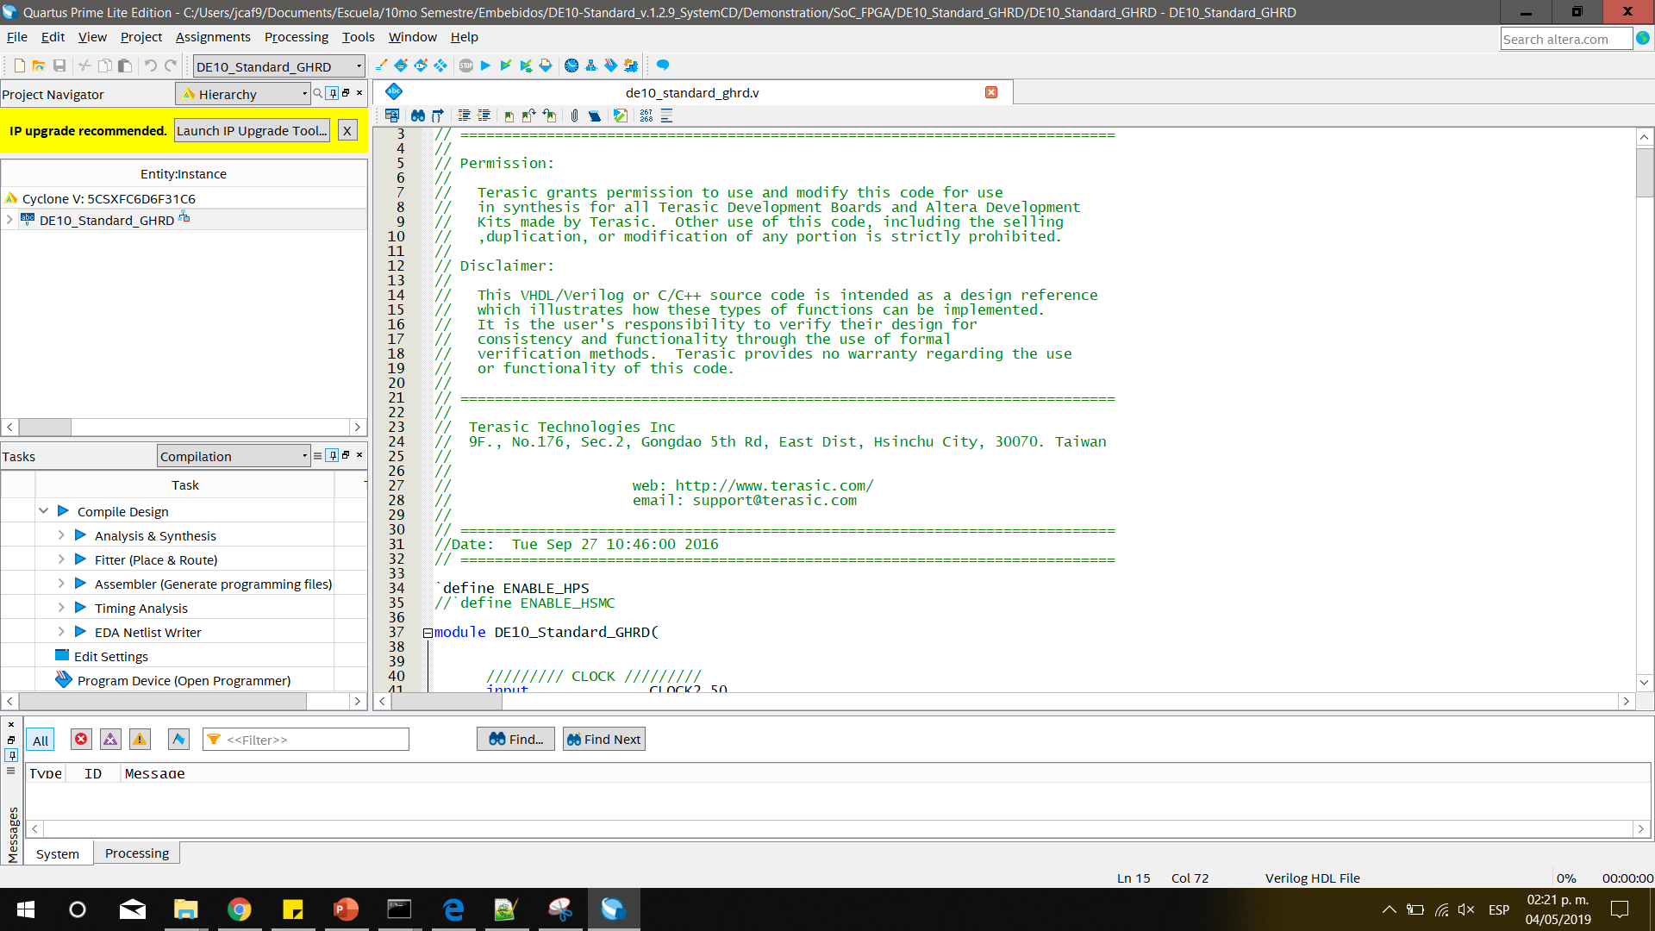
Open the verilog file to verify how the connections are configured

Slide 24
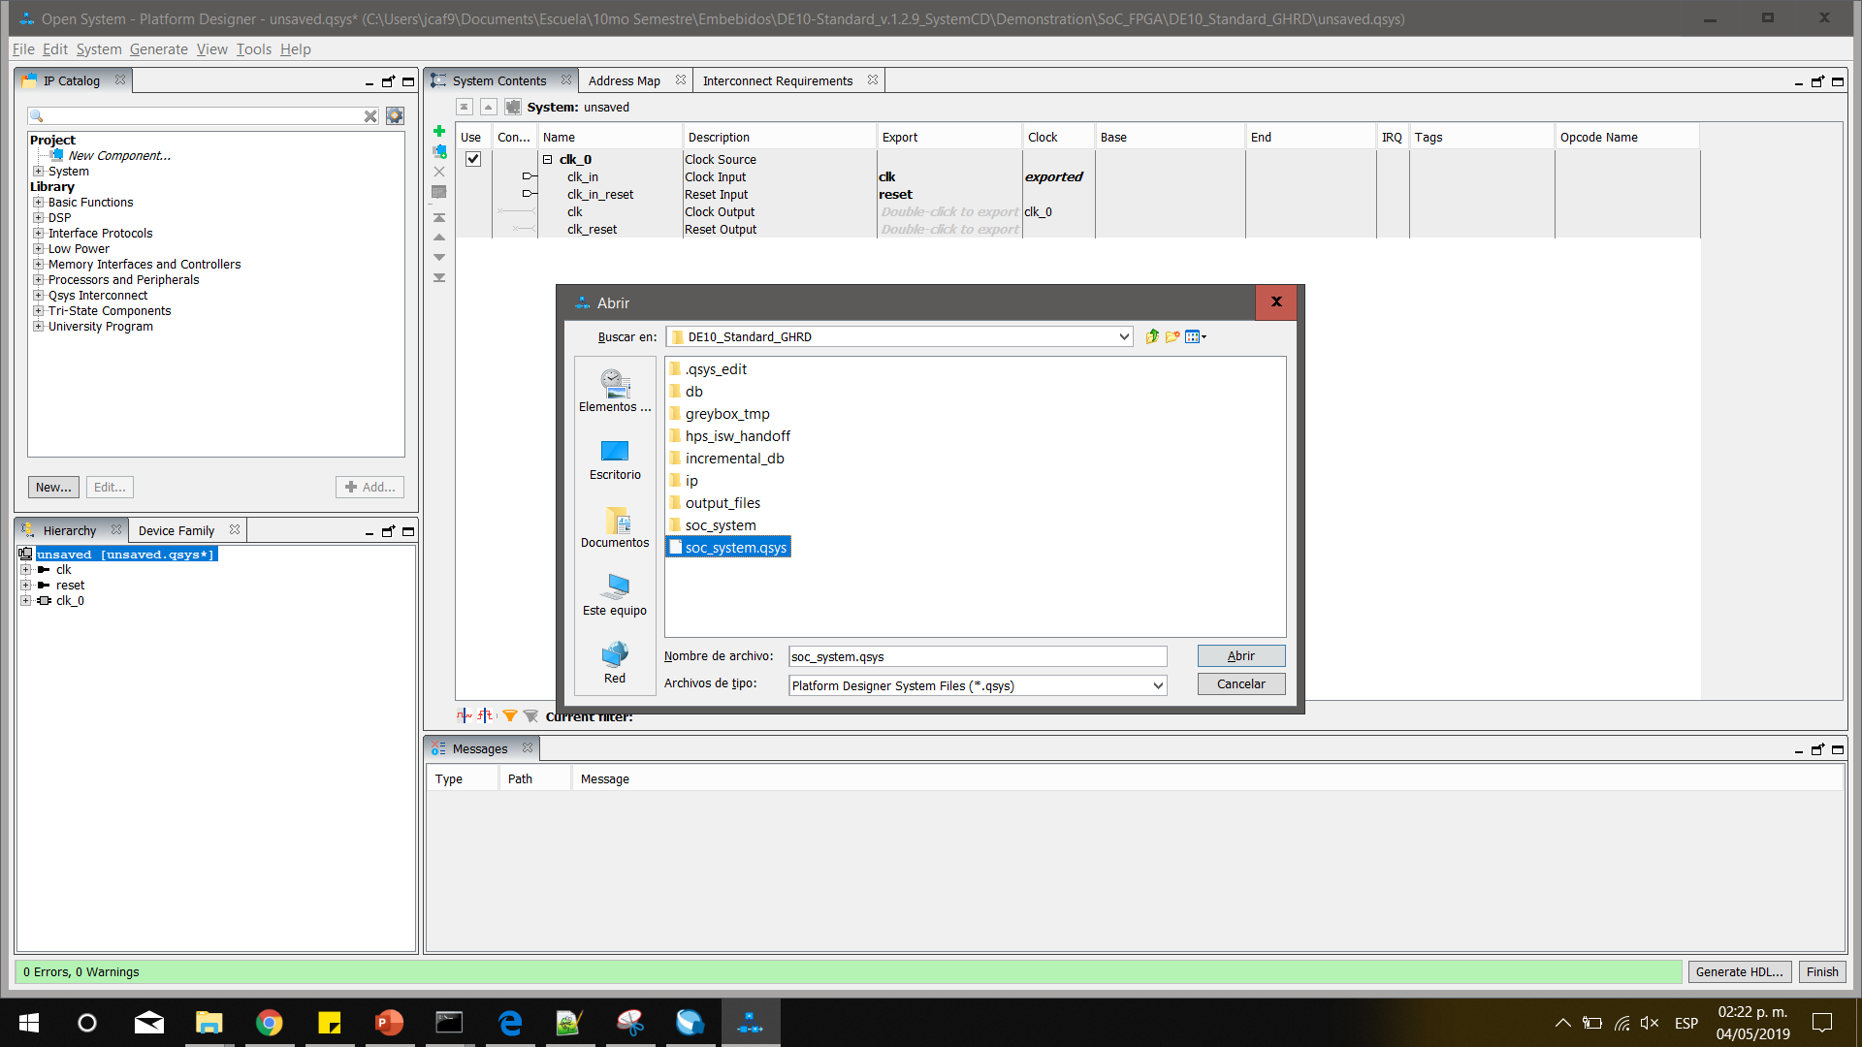
Open the platform designer which manages the Qsys file

Slide 25
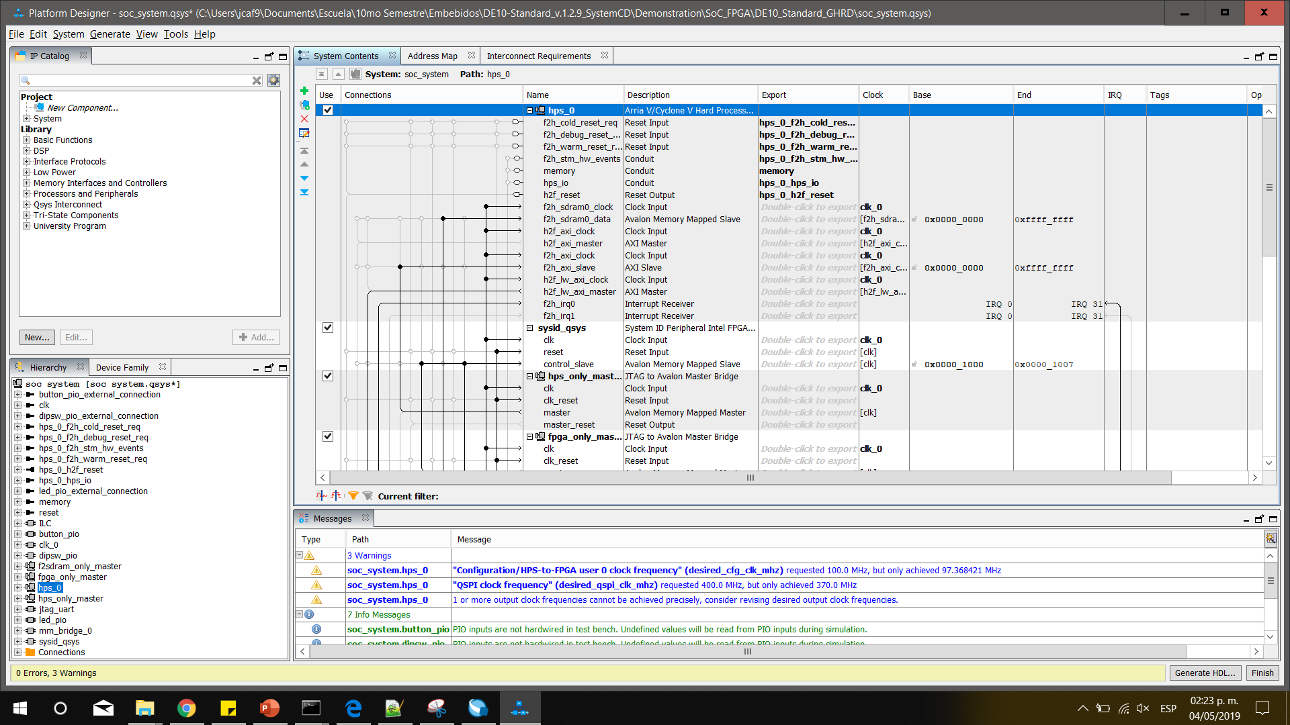
Once loaded, you can verify the memory mapped devices

Slide 26
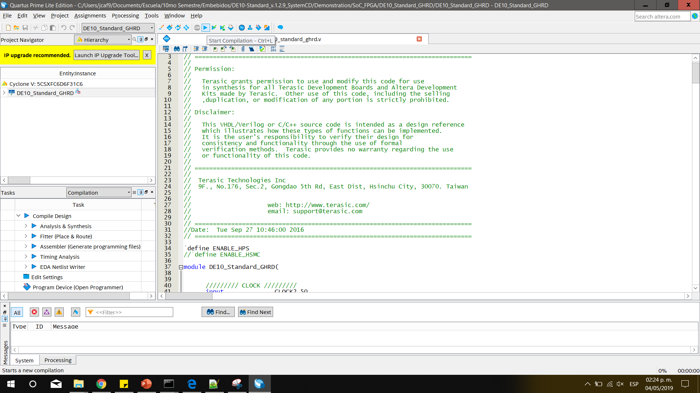
If you did any changes to any of the files, you have to compile everything by clicking theon Start Compilation

Slide 27
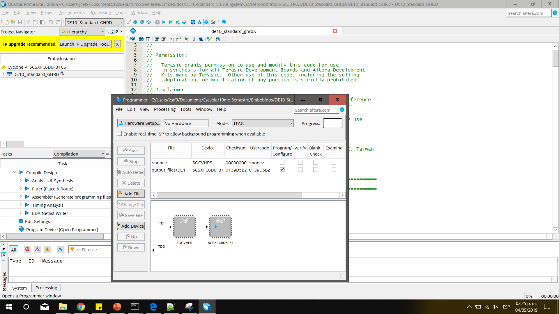
Once compiled, open the Programmer

Slide 28
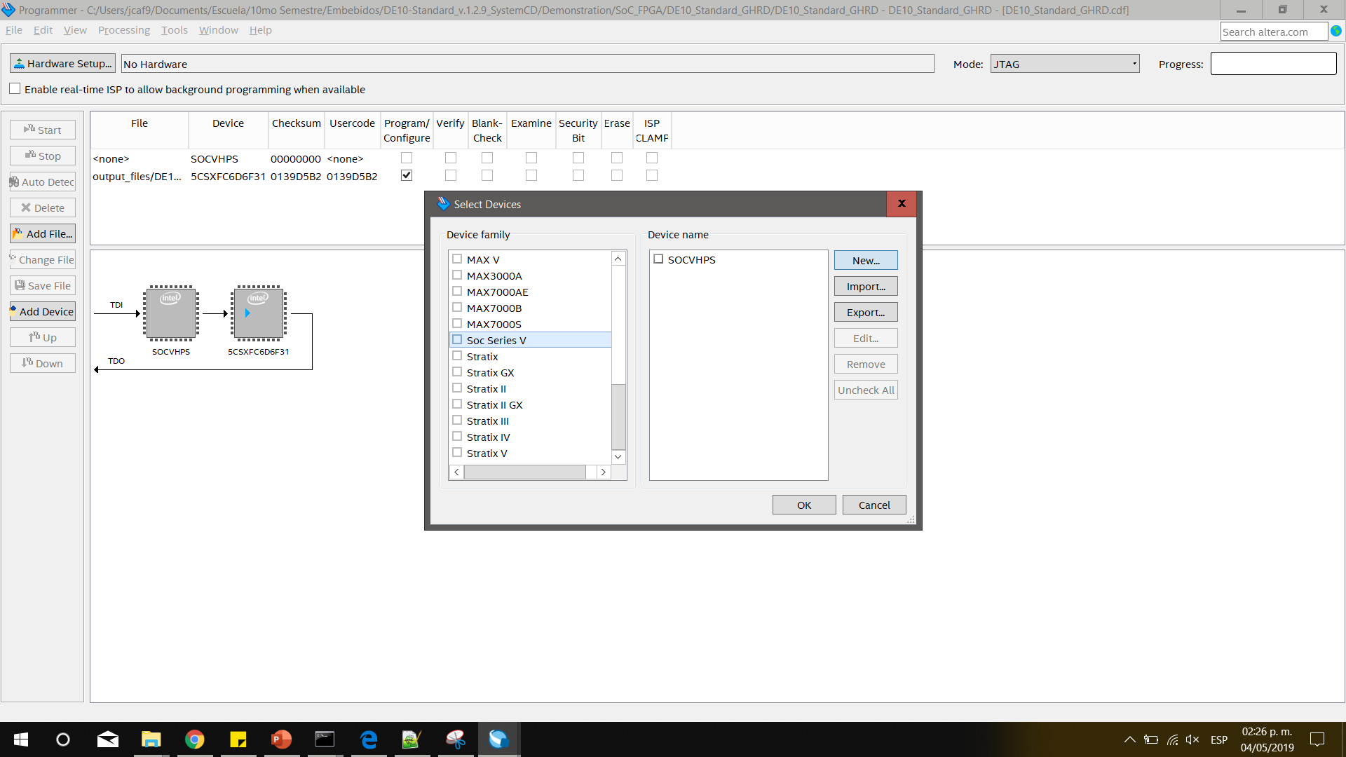
Make sure the device SOCHPSV is added, if not, add it

Slide 29
Once added click on start
Wait for the progress to finish, and now you are able to communicate the HPS with the FPGA devices.
To test this open your EDS and transfer the HPS_FPGA_LED executable in the HPS_FPGA_LED folder provided on the CD to your device.

